Slide 1
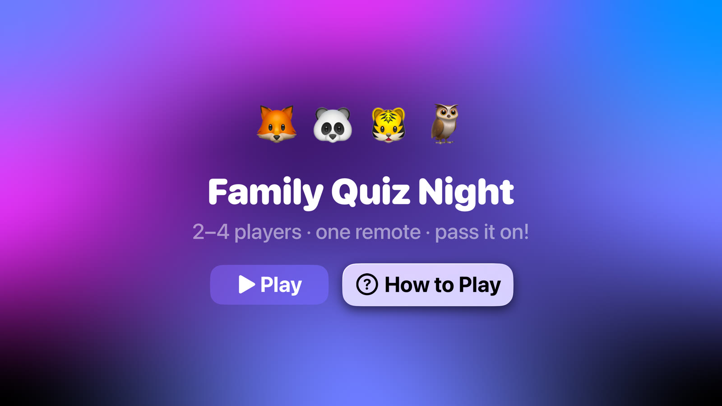
Family Quiz Night
The living-room quiz for 2–4 players on Apple TV. One remote, no phones, pass it on.
Asan M A M · IT22253262 · SE4041 Assignment 02 Part B
Notes:
Introduce the app in one sentence: a quiz game the whole family plays together on the TV, sharing one Siri Remote.

Slide 2
Family time has moved to separate screens
1
2
3
Everyone on a phone
The TV is only watched
Party games need setup
Evenings at home are spent side by side, each person on their own device.
The biggest screen in the house is used passively; very few TV games are made for families.
Popular party games ask every player for a phone, an account or extra controllers.
Opportunity: a game the whole family plays on one shared screen, with nothing to install or sign in to.

Slide 3
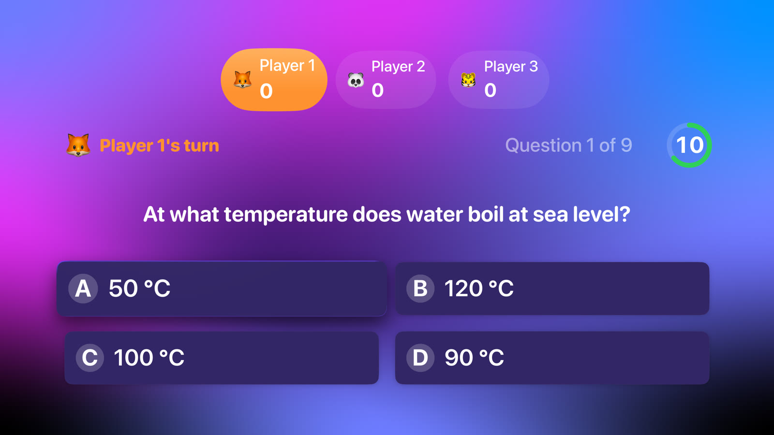
One remote, taking turns on the big screen
Hot-seat turns: the remote is passed to the next player after each question
Scoreboard shows whose turn it is, from across the room
15-second timer with a speed bonus keeps it lively
Three categories plus a Mixed Bag, including a Sri Lanka round

Slide 4
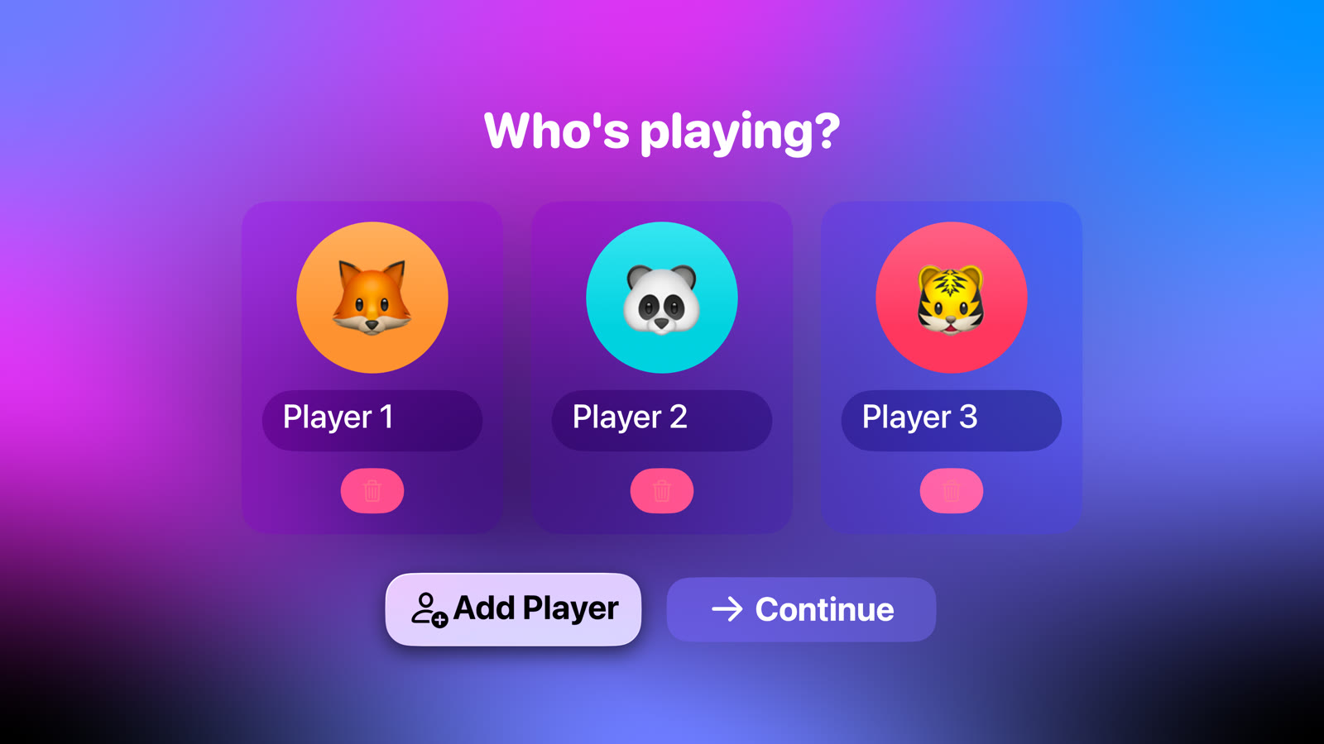
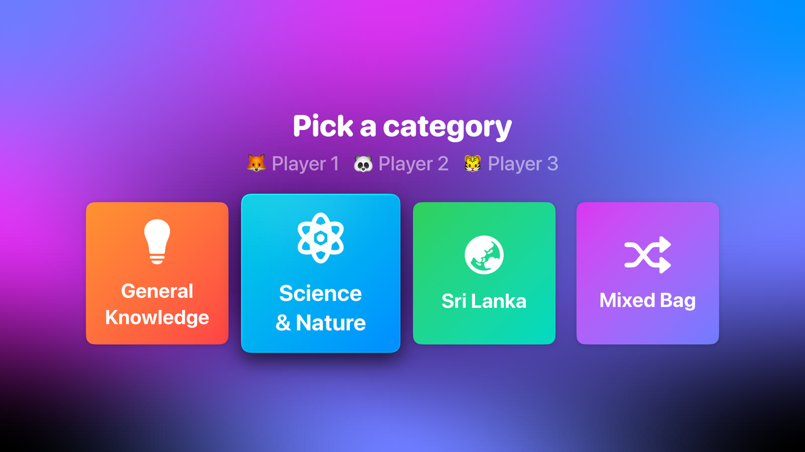
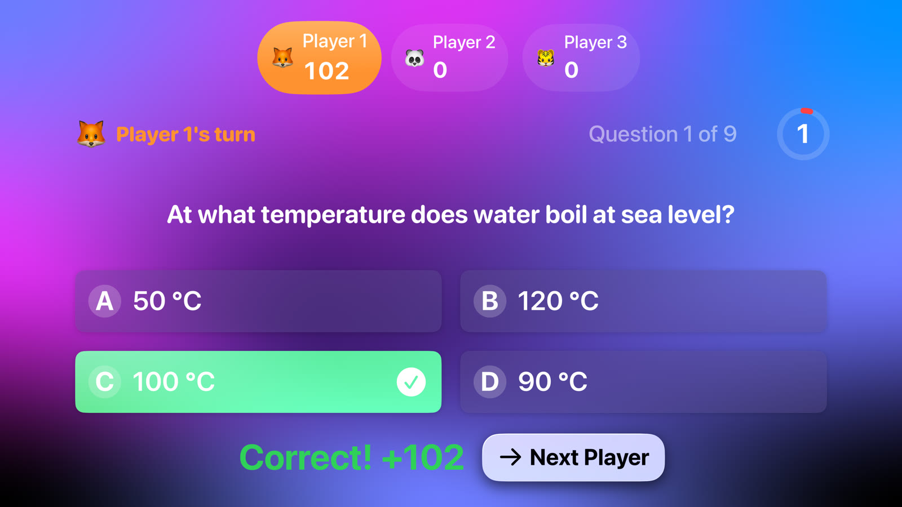
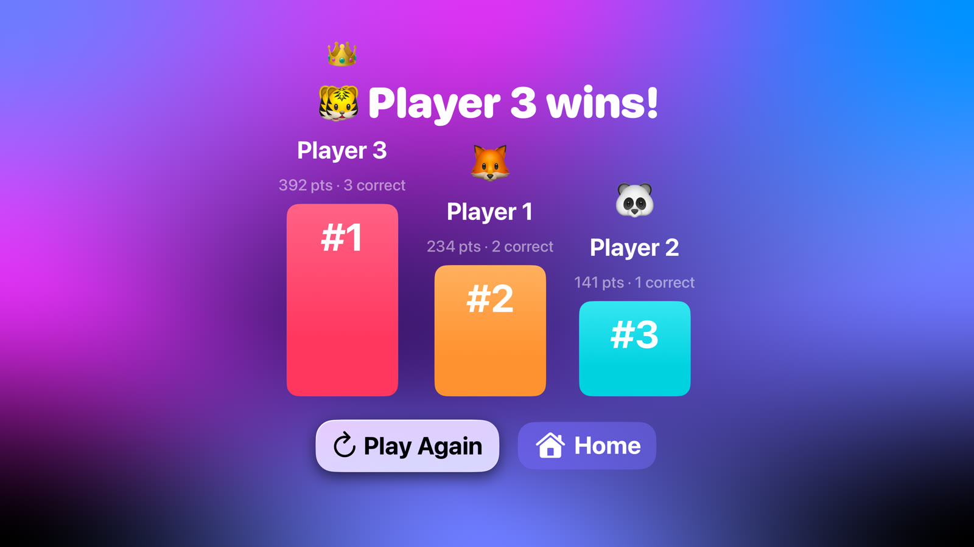
A full game in four steps
1
Add players
2
Pick a category
3
Answer in turn
4
Crown the winner
2–4 players, each with an animal and colour
Tiles lift and tilt under focus
Correct = 100 points + up to 50 for speed
Podium, draws handled, Play Again

Slide 5
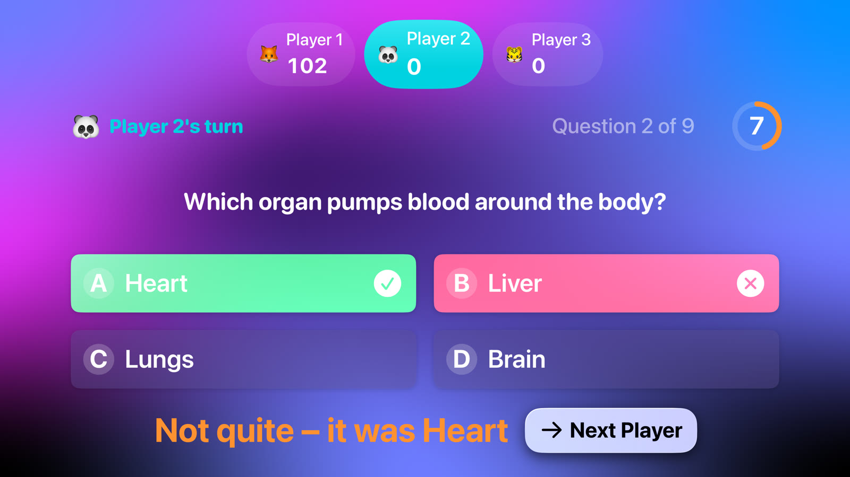
Built for tvOS, not ported to it
Focus engine: answer cards lift and tilt as you swipe
Siri Remote only: swipe, click, Back to pause or quit
Multi-user: turn rotation, per-player colour, live scoreboard
Readable from the sofa: large type, high contrast
Animated mesh-gradient background, shake on wrong answers

Slide 6
Similar apps need a phone for every player
App | How people play | Where Quiz Night differs
Kahoot! | Questions on a shared screen; every player answers on their own phone | No phones or accounts; one remote
Jackbox Party Packs | Game on the TV; players join and play from phones or browsers | Nothing to join; built for families and children
Trivia Crack | Mobile trivia, mostly one-to-one against online opponents | Played together, in the same room
Heads Up! | Party guessing game on a single phone held up to the forehead | Uses the TV so everyone can see

Slide 7
Who it is for
1
2
3
Families with children 8+
Friends and gatherings
Classrooms
Parents looking for a shared, screen-based activity that isn't passive viewing.
Festive seasons and get-togethers, e.g. Sinhala and Tamil New Year.
Teachers running a quick revision quiz on a classroom Apple TV.
Beachhead: Apple TV households in Sri Lanka, with local content the global apps don't offer.

Slide 8
Value proposition
1
2
Zero setup
Fair for all ages
Open the app and play. No accounts, downloads or phones.
Speed bonus rewards quick answers; turns give everyone a go.
3
4
Local content
Private by design
A Sri Lanka category that global quiz apps don't have.
No sign-in, no ads to children, nothing leaves the TV.

Slide 9
Revenue model (proposed)
F
P
S
Free to play
Question packs
Family Plus
Core game with three categories, so families can try it with no risk.
One-off in-app purchases: movies, sport, science, school syllabus packs.
Optional subscription: every pack, custom quizzes written on iPhone, school licences.
Sold through the App Store with Family Sharing, so one purchase covers the household.

Slide 10
Go-to-market in three phases
LAUNCH
GROW
EXPAND
Sri Lanka App Store
Schools and seasons
Languages and buzzers
Free version with the Sri Lanka category; launch around New Year when families gather
Teacher packs for classrooms; themed packs for Vesak, Christmas and cricket season
Sinhala and Tamil questions; iPhones as optional buzzers for 5+ players

Slide 11
A working, tested prototype
13
3
36
5
unit tests
UI tests driven by the Siri Remote
questions in 3 categories
screens, MVVM architecture
SwiftUI on tvOS 26 · @Observable game engine with no UI code · NavigationStack routing · focus-aware custom components

Slide 12
Let's play
Live demo on the Apple TV simulator.
Thank you – questions welcome.
Asan M A M · IT22253262

